Slide 1

VFW AUXILIARY MEMBERSHIP MOMENT
How to Ensure a Membership Application is Complete

Slide 2
GETTING STARTED
One of the most critical steps in considering a new member for the VFW Auxiliary is the careful review of the prospective member’s application details by a three-member Investigating Committee appointed by the Auxiliary President (as outlined in Section 102 of the VFW Auxiliary Bylaws and Ritual).
As an exclusive veterans’ service organization, the VFW Auxiliary must ensure that every prospective member’s eligibility has been thoroughly vetted by an Investigating Committee before any action can be taken on the application. According to Page 1 of the VFW Auxiliary Booklet of Instructions, “it is the duty of the Investigating Committee to see that the applications are filled out completely before they are presented to the body for consideration.” The following fields are to be completed on each application:
• Recruited by
• Auxiliary Name and Number
• Kind of Membership (annual, life, etc.)
• State
• Name (spelled correctly)
• Date of Birth
• Address
• Gender
• City, State, Zip
• Phone
• E-mail
• Post Affiliated or Non-Affiliated
• Relationship
• Veteran (name)
• Post Number (if applicable)
• Name of campaign ribbons or medals
• Foreign Service dates
• Location
• Applicant’s signature and date
• Signatures of the Investigating Committee (at least 2)
• Signature line following the Obligation

Slide 3
INVESTIGATING COMMITTEE DUTIES
In addition to the prospective member’s application, it is the responsibility of the Investigating Committee to review proof of honorable service of the eligible veteran, unless he/she is a member of the VFW Post to which the applicant is applying for membership.
Proof of the veteran’s honorable service in any foreign war, insurrection or expedition (as a member of the U.S. Armed Forces) may be determined through careful examination of a Separation Document (DD214) with a VFW-authorized campaign or service medal of the United States; receipt of Hostile Fire or Imminent Danger Pay, as verified by a copy of a Leave and Earning Statement (LES) issued by the U.S. Armed Forces; or service in Korea for 30 consecutive/60 non-consecutive days after June 30, 1949.
Performance reports, travel orders, medical orders, medals reports, morning reports, assignment listings, buddy affidavits, and letters from a foreign war zone may also be reviewed if a DD214 is not available. For veterans pre-1946, a report of their discharge listing the medals and decorations that were earned is acceptable proof
For soldiers currently on active duty, they will not have a DD214. In those cases, the appropriate orders showing overseas deployment to a qualifying area, or awarding of an authorized campaign medal, or a LES showing Hostile Fire/Imminent Danger pay will suffice to prove eligibility

Slide 4
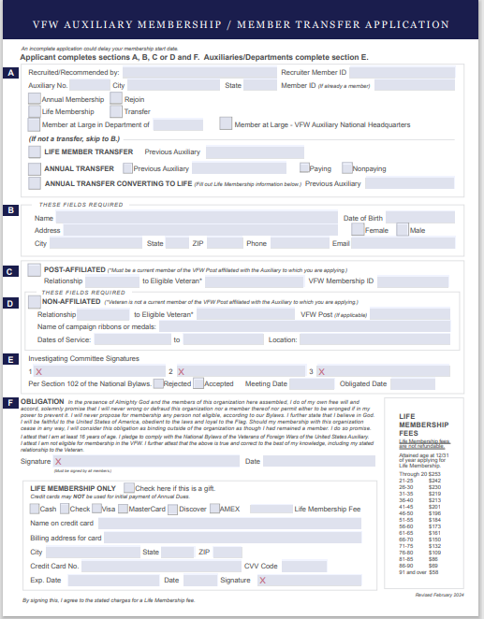
VFW AUXILIARY
MEMBERSHIP APPLICATION

Slide 5

PART A:
Recruited or recommended by: The individual who is recommending (recruiting) the applicant for membership to the auxiliary. The individual recommending the applicant cannot be one of the Investigating Committee members signing the application.
Recruiter Member ID: This is the Recruiter’s Member ID. National now keeps track of this for auxiliary recruiters and they will mail Recruiter pin(s) when the criteria has been met. If the Recruiter Member ID is missing or incorrect, it will not be entered into MALTA at the time of processing.
Auxiliary Number: is the VFW Auxiliary No the member is joining/transferring to
City: The city in which the Auxiliary is located.
State: The State which the Auxiliary is located in (Florida)
Member ID (if already a member): If the applicant is a current, lapsed or former member of another auxiliary, their Membership ID number must be provided.
Mary Recruiter
20003332221
9272
Seminole
Florida
EXAMPLE

Slide 6
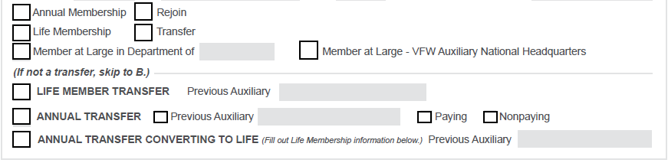

PART A:
Annual Membership: If the applicant is obligated at any time after July 1, the dues paid shall be for the next succeeding calendar year. If the applicant is obligated any time prior to July 1, the current year dues must be paid and then before 12/31, the next succeeding year’s dues must also be paid. Membership run from January 1 to December 31.
Rejoin: is someone who has not paid their dues by June 30th. Starting July 1^{st,} they must start the process over again as a new member…. but will retain the same Membership ID number.
Life Membership: Lifetime members pay a one-time membership fee based upon their age at the time of joining the auxiliary. The life membership fees are located on the lower right-hand side of the application.

Slide 7
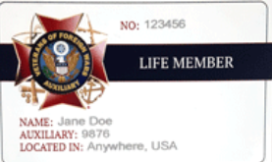
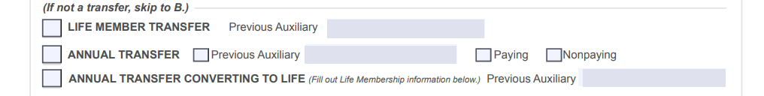
PART A: (Continued)
Life Member Transfer Previous Auxiliary: Check this box if a lifetime member is transferring into your auxiliary. You must provide the Auxiliary No from where they are transferring from and if auxiliary is from another state, you must also provide the State where the Auxiliary is located.
Annual Transfer Previous Auxiliary: Check this box if a current annual member is transferring into your auxiliary. You must provide the Auxiliary No from where they are transferring from and if auxiliary is from another state, you must also provide the State where the Auxiliary is located.
Paying or Not Paying: If the member has not yet paid their annual dues, they must pay at the time of transfer.
Annual transfer converting to life: The member is a current annual member and wants to rejoin/transfer as a Life Member. The Auxiliary No and State, if other than Florida, where the member is transferring from must be provided
TRANSFERS

Slide 8
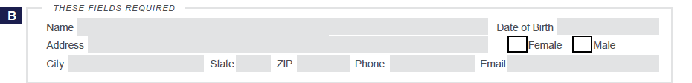
PART B:
Name: As they want it on the card Date of Birth: Must be provided
Address: Where mail is received Female or Male Check the appropriate box
City/State and Zip: Where mail is received
Phone number and Email address: If no phone number or email address indicate “NONE” Please ensure that the email address is clearly written.

Slide 9


Slide 10
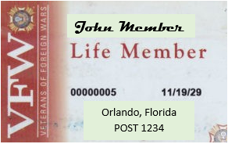
PART C:
Post-Affiliated: Check this box if the applicant is joining the Auxiliary under a current VFW member from your Post.
Important Reminder: The VFW Member the applicant is joining under as a ‘Post-Affiliated’ must be a member of the same VFW Post associated with the Auxiliary accepting the application.
Relationship: Mother, Father, Sister, Brother etc.. To Eligible Veteran: the veteran’s name VFW Membership ID: The VFW member must be a current member of the VFW Post (not deceased) and the VFW Membership ID # must be provided.
MUST BE PROVIDED

Slide 11
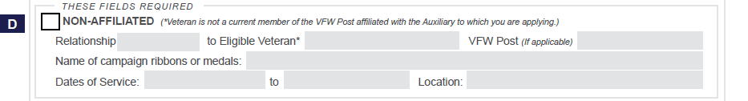
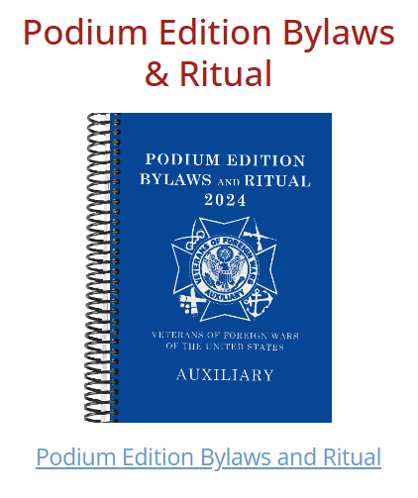
PART D :
Non-Affiliated: the eligible veteran is not a member of the VFW Post to which the applicant is joining
Relationship: Mother, Father, Sister, Brother etc.... To eligible Veteran: the veteran’s name
Name of campaign and any ribbons or medals: As found on DD214 or other paperwork available. You should always reference the National Auxiliary Bylaws page 6-11 and follow the guide in determining eligibility.
Note: There is no need to list all medals/ribbons, only those that qualify the veteran for the VFW, i.e., Vietnam Service Medal, Asiatic-Pacific Campaign, American Campaign, Korean Service Medal)
Dates of Service: the day they joined the military to the day they separated from the service.
Location: Foreign location where the veteran served….not the base where they served after returning to US
NOTE: The following does not qualify the applicant for the VFW Auxiliary under the service of their veteran:
National Defense Medal
WWII Victor Medal (only WWI Victory Medal) or just the notation WWII, unless foreign location provided or if the veteran was stationed at ‘Pearl Harbor’ at the time of hostile wartime.
Reference Pages 6 – 11 in the Podium Edition Bylaws and Ritual available in MALTA under Member Resources

Slide 12
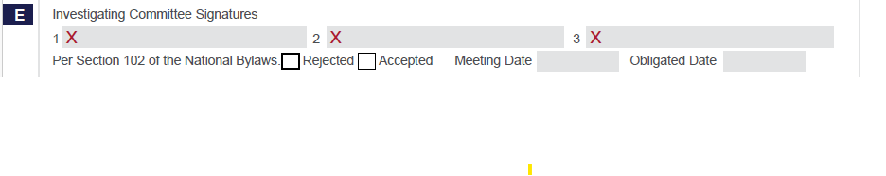
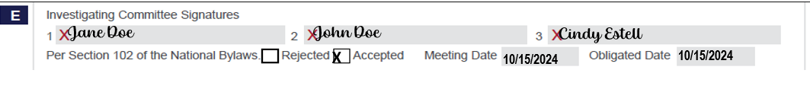
PART E:
Investigating Committee Signatures: Must have at least two (2) Investigating Committee signatures and cannot also be listed as the Recruiter (Refer to Section 102 of the National Bylaws)
Rejected: the applicant was not approved by a vote of the auxiliary to become a member
Accepted: the applicant was approved by a vote of the auxiliary to become a member
Meeting Date: The meeting date that the application was rejected or approved by the members. This date must be included on the application before sending to Department for processing.
Obligated Date: This is the date the applicant signed the OBLIGATION at the bottom of the Membership application or the Meeting Date if you are unsure of the signature date.
EXAMPLE
The signature of the member recruiting/recommending the applicant cannot also be one of the Investigating Committee Signatures for the applicant

Slide 13
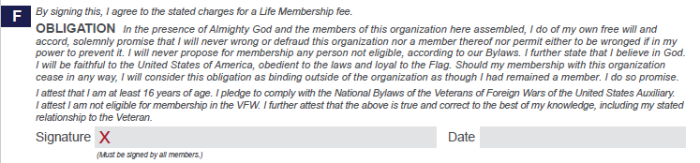
PART F:
Obligation: this is the obligation from the applicant/member to the auxiliary and their attest that all the information on the application is true and correct.
Signature and Date: the applicant/member’s signature and date of signature

Slide 14
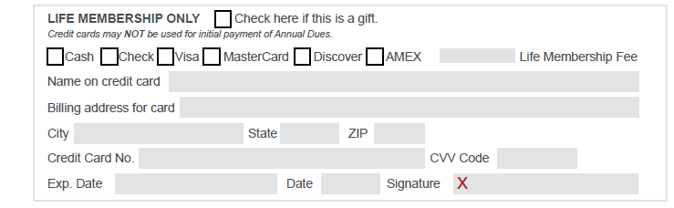
Life membership Credit Card: LIFE MEMBERSHIP ONLY. (Initial payment for an annual membership cannot be paid by credit card)
Check here if this is a gift: It will be sent to the Auxiliary Treasurer’s address. Check the box.
What kind of credit card it is. You will check the box that applies.
Amount of the life membership: The life membership fees are located on the bottom right side of the application. Use the age the applicate will be by 12/31 of the year they are becoming a member.
Name: Exactly as it appears on the credit card
Address: The exact address that is on the credit card account. City, State and Zip Code: Associated with the credit card account
The Credit Card No: American Express has 15 and all other have 16. If possible, ask to see the credit card and verify that the correct number is provided and is printed clearly. .
CVV Code: Is found on the back of the card it is a 3-digit number or 4-digit for American Express. Make sure this is printed clearly
Exp Date: When the credit card expires. Date: of when the member is signing Signature: Must be the Signature of the Credit Card.
ALL INFORMATION MUST BE LEGIBLE - PRINT CLEARLY!!!!!

Slide 15

CREDIT CARD
PAYMENTS
Credit Card payments are accepted for Life Membership Fees only…
Name and Billing address provided MUST match exactly as it appears on the card holders credit card account
Ensure that the full Credit Card No., CVV code and Expiration Date are legible and PRINTED CLEARLY
The signature must be that of the Name on the credit card if the Life Membership fee is being paid by someone other than the applicant
The Date signed by the credit card holder must be within four (4) months of the date submitted to the Department Treasurer for processing. If the Date of Signature is more than four (4) months, the application is considered stale dated and the credit card payment cannot be processed. A new application must then be acquired with an updated Signature Date..
X
$173
EXAMPLE
Jane Marie Doe
123 Main Street AptB
Anywhere
Florida
33333
4444 5555 6666 1111
001
01/2222
10/02/2024
Jane Marie Doe

Slide 16
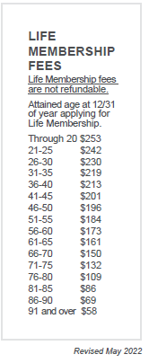
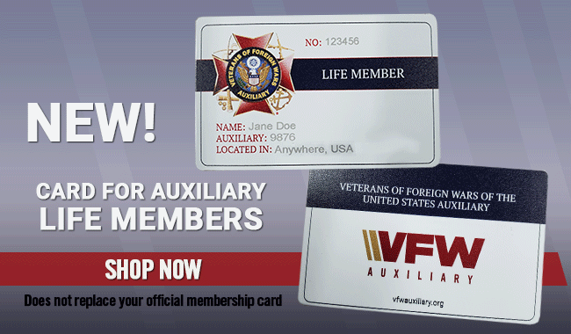
Life membership fees are determined based on the age the applicant will be by 12/31 of the year they are becoming a member.
For Example:
Date of Birth: 10/17/1954
Date of Application: 08/15/2024
2024
- 1954
70 the age the applicant will be by 12/31/2024
Life Membership Fees due with the application are $150

Slide 17
VFW AUXILIARY
MEMBERSHIP APPLICATION

Slide 18
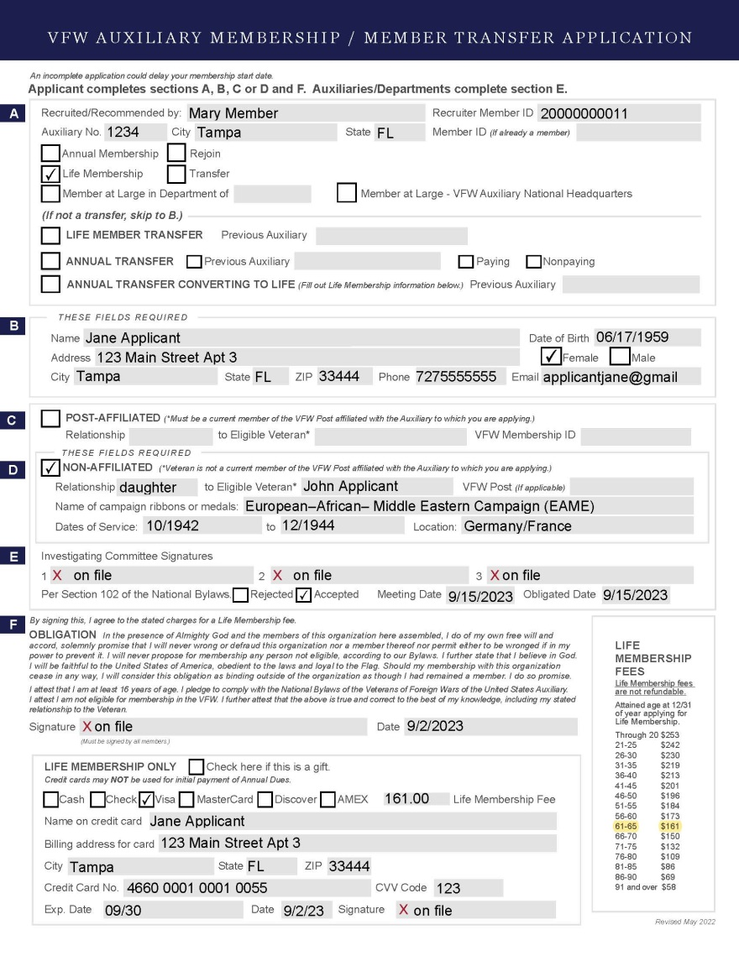
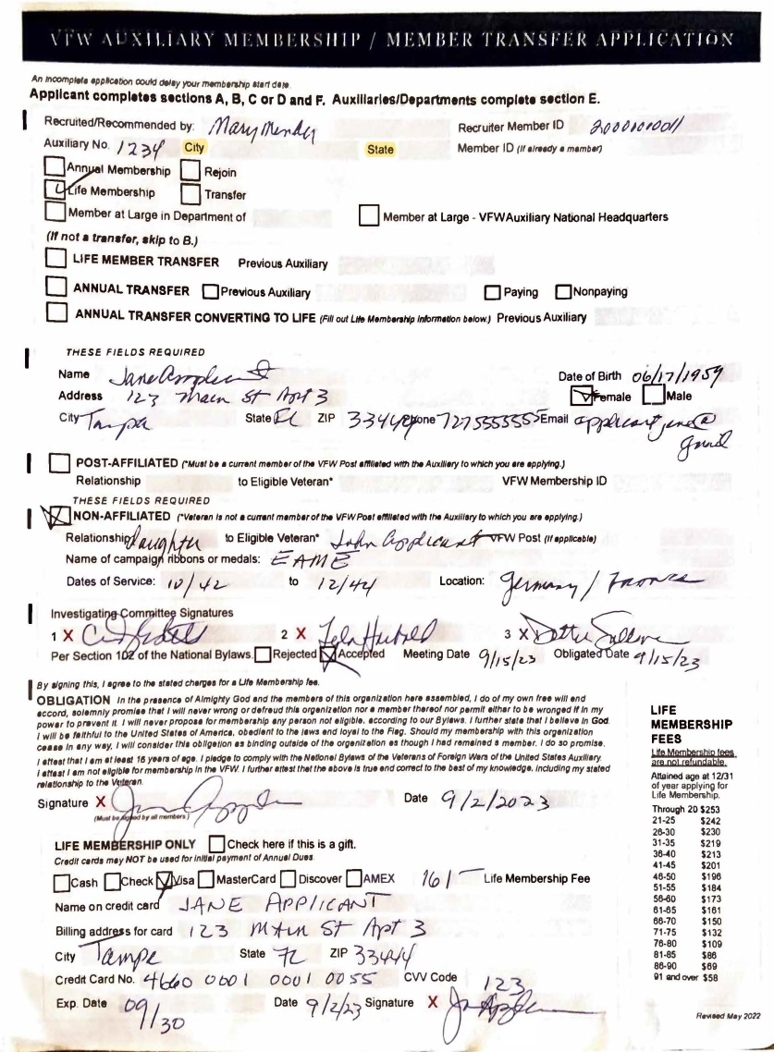

Slide 19
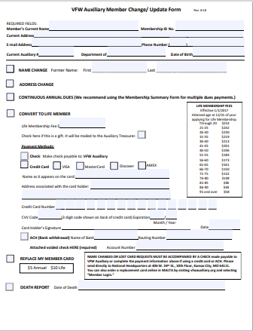
MEMBER UPDATE/CHANGE FORM
Use for a Convert to Life

Slide 20
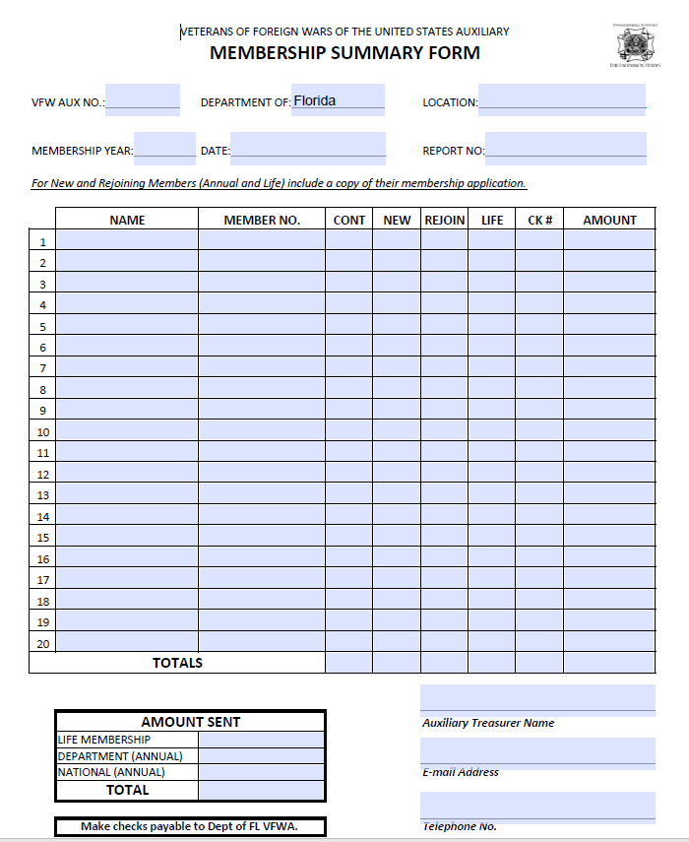
VFW AUXILIARY
MEMBERSHIP SUMMARY FORM

Slide 21
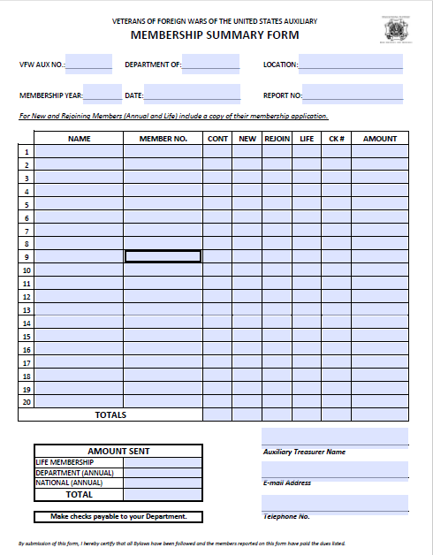
If using one (1) transmittal for all applications being submitted, categorize the applications..
All Annual Applications paid by check
All Life Membership Applications paid by check
All Applications being paid by credit cards
Preferred Method….
All Annual and Life Membership Applications paid by check listed on same transmittal but listed categorically
All Applications being paid by credit cards listed on separate transmittal

Slide 22
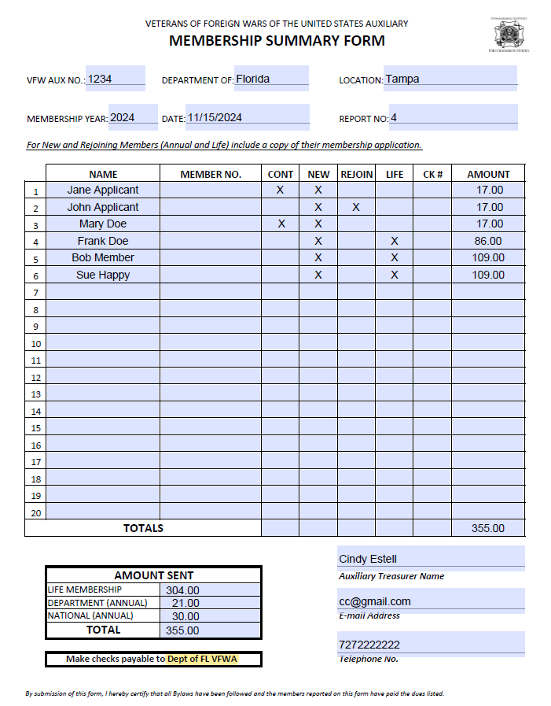
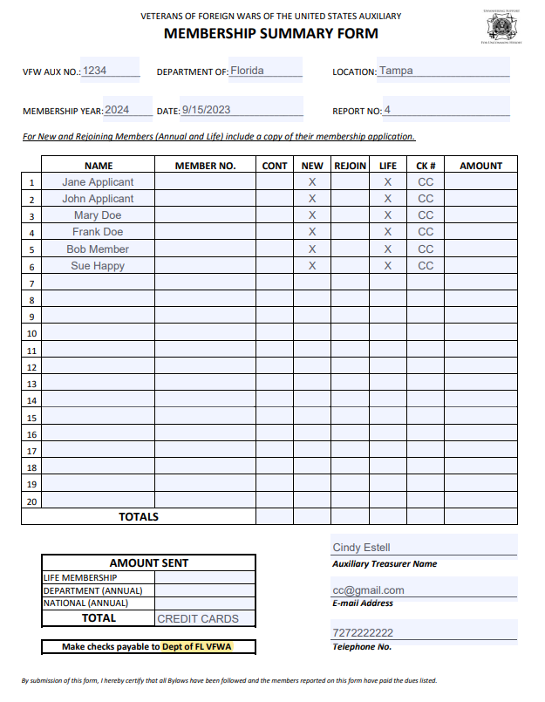

Slide 23

WHERE TO MAIL MEMBERSHIP APPLICATIONS FOR PROCESSING
Cindy Estell, Dept Treasurer
PO Box 55850
St Petersburg FL 33732-5850

Slide 24

www.vfwauxfl.org
RESOURCES/TREASURER AND TRUSTEE

Slide 25

Membership can help for years to come

